Slide 1




Shield Insurance
CUSTOMER & REVENUE
ANALYSIS
Notes:
Hello everyone! As part of my virtual internship in Codebasics Bootcamp, I worked on a pilot project for a fictional company called Shield Insurance.
In this project, I created an interactive Power BI dashboard to analyze their customer base, policy performance, and revenue trends.

Slide 2

Shield Insurance
Company Profile
Shield Insurance is a customer-focused insurance provider committed to delivering comprehensive and reliable coverage across a range of products. The company aims to protect individuals and families by offering policies tailored to their needs, including life, health, and motor insurance. With a growing customer base and a focus on digital transformation, Shield Insurance strives to make insurance accessible, transparent, and easy to manage.
Notes:
Here is the company profile. Shield Insurance is an insurance provider with a varied range of products. It aims to protect individuals and families by offering insurance policies according to their needs. The company’s focus is to make insurance accessible and transparent.
transform the business by taking data driven decisions.

Slide 3
Shield Insurance
Business Overview
Shield Insurance offers a range of products and services in the insurance sector, designed to meet diverse client needs.
Offers 9 policy types with reasonable base coverage and premium amounts.
Serves customers across all age groups and multiple cities.
Operates through 4 sales modes – both online and offline.
Built a diverse and growing customer base through varied channels.
Notes:
In order to meet diverse client needs, shield insurance offers 9 policy types and serves customers across all age groups and cities. It also operates through 4 sales modes – both online and offline.

Slide 4
Shield Insurance
Project Goal
To build an interactive Power BI dashboard that enables the insurance company to:
Understand total customers and revenue generated, including daily growth rates.
Monitor month-over-month changes in policy performance and customer behavior.
Segment and analyze customers by age group and city to uncover key demographics.
Switch between revenue and customer trend visuals for focused analysis.
Apply dynamic filters for sales mode, city, month, age group, and policy ID.
Understand revenue and customer distribution across channels.
Identify preferences, expected settlements, and trends by age.
Notes:
Here are the details about project goal. To mention a few, we aim to understand total customers and revenue along with daily growth rates. To get clarity on month-over-month changes in policy performance and customer behavior. To Understand revenue and customer distribution across channels and Identify preferences, expected settlements, and trends by age.

Slide 5
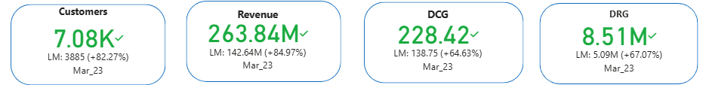
Key Performance Indicators
These metrics indicate fluctuations across key areas, with significant growth in both customer acquisition and revenue generation in the month of March.
Notes:
We have four KPI’s analysed from Nov 2022 – Apr 2023. They fluctuated across months amongst which march stayed as the highest performing month.

Slide 6
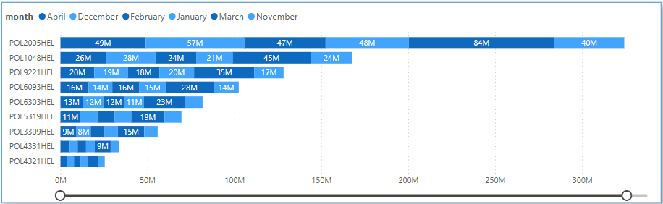
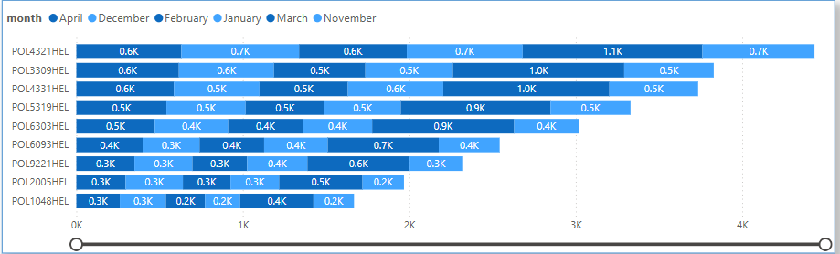
Policy Changes on month-on-month basis
Policy POL4321HEL attracted more customers.
Policy POL2005HEL generated maximum revenue.
Notes:
Here I have used a stacked bar chart to analyse policy changes on month-on-month basis. This helped in understanding which policy performed well in terms of attaining customers and generating revenue.

Slide 7
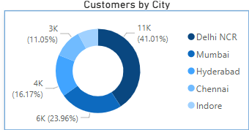
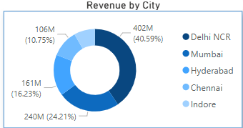
Customers and Revenue by City
Delhi NCR is at the top of the chart with around 11k customers(41.01%) and 402M revenue(40.59%).
Indore is at the bottom with around 2k customers(7.81%) and 81M revenue(8.22%)
Notes:
Donut chart is used to represent customers and revenue by city. In both the metrics delhi ncr is in the lead with around 11k customers and 402M revenue and indore at the bottom with around 2k customers and 81M revenue.

Slide 8
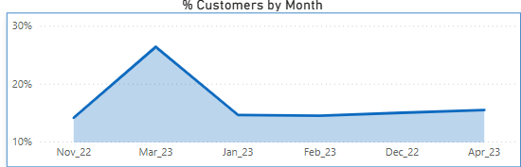
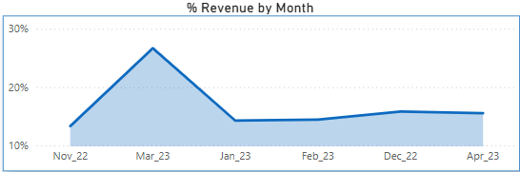
Customers and Revenue by Month
In March month shield insurance acquired maximum customers which accounts to 26.38% and generated maximum revenue with a share of 26.67%.
Notes:
When analysed the % customers and % revenue acroos months, march accounts to 26.38% of customer base and contributed to 26.67% of the revenue.

Slide 9
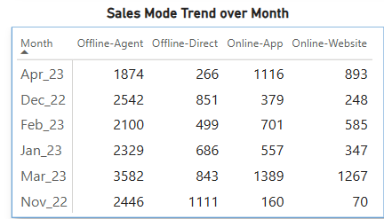
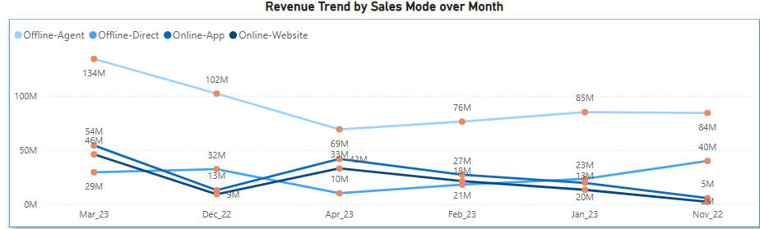
Sales Mode Analysis
Amongst all the channels Offline-Agent mode generated maximum revenue across all the months and proved to be an effective sales mode.
Notes:
As shown in the line chart where revenue is calculated for different sales modes across months and the table where sales mode trend is observed. Offline agent channel proved to be the efficient one.

Slide 10
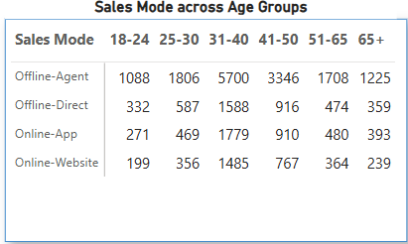
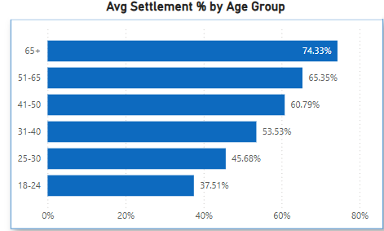
Age Group Analysis
Offline-Agent channel attracted customers across all age groups.
Average settlement percent is larger for 65+ age group.
Notes:
In our age group analysis, Again offline agent channel was majorly chosen by all the age groups as shown in the table. When Avg settlement % which is the policy settlement percentage of an age group is calculated 65+ age group had the max perce.

Slide 11
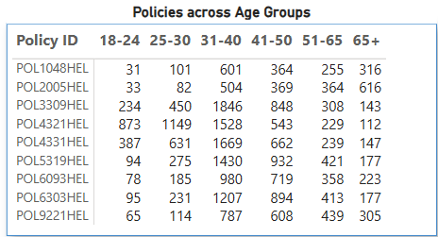
Age Group Analysis
Policies POL4321HEL, POL3309HEL, and POL4331HEL showed significant popularity across multiple age groups, particularly among customers aged 31–40 and 41–50.
Notes:
When the popularity of policies was analysed , po4321hel was on the top. And age groups 31-40 are interested to take up an insurance policy.

Slide 12
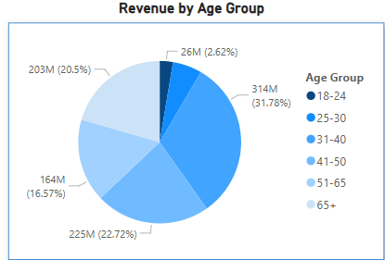
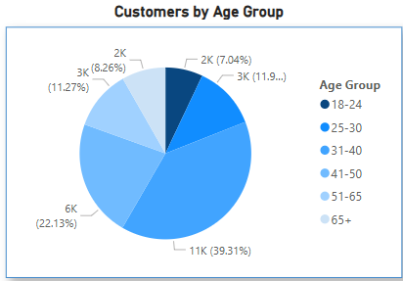
Age Group Analysis
Age Group 31-40 accounted for the highest number of policy purchases, leading to the largest contribution in overall revenue.
Notes:
As shown in the pie-chart 31-40 accounted as the largest policy holders while 18-24 contributed very less to the company.

Slide 13
Insights Overview
Analysis of Policy Trends on Month-on-Month basis highlights the importance of tracking both customer uptake and revenue contribution to identify high-impact insurance products.
City wise analysis highlights a strong regional concentration in Delhi NCR, suggesting potential for targeted expansion in lower-performing cities.
March was a peak performance month, signaling successful campaign efforts or seasonal demand factors.
Offline-Agent channel proved to be the efficient sales-mode.
Policies POL4321HEL, POL3309HEL, POL4331HEL demonstrated strong appeal and adoption, making them key drivers of overall business performance.
31-40 age group represents a critical target group for future sales and marketing strategies.
Notes:
From all the insights few takeaways are City wise analysis suggests targeted expansion in lower-performing cities. March signals successful campaign efforts. Offline agent channel proved to be the efficient sales mode. 31-40 age group represents a critical target group and the top3 policies as shown are the key drivers for overall business performance.

Slide 14
Shield Insurance
Thank You!!

